Slide 1
DeFi and Crypto-Assets under the MiCA Framework
New Frontiers and Challenges for Financial Supervision
ANTONIO RUSSO
Head of the Cash and Derivatives Market Operations Office
(CONSOB)
This statement is made in a personal capacity and does not in any way bind the administration to which the author belongs

Slide 2
DeFi and Crypto-Assets under MiCA
A Supervisory Perspective
Focus: How decentralised finance challenges existing financial supervision
Key idea: DeFi exposes gaps in traditional regulatory frameworks (MiCA as a reference boundary, not a solution)
Purpose: Frame supervisory questions for interdisciplinary discussion

Slide 3
WHY DeFi matters for supervisors
DeFi changes how financial activity is organised, shifting where risks emerge.
Lack of intermediaries and governance complicates supervision and accountability.
Global and cross-border structures weaken territorial oversight.

Slide 4
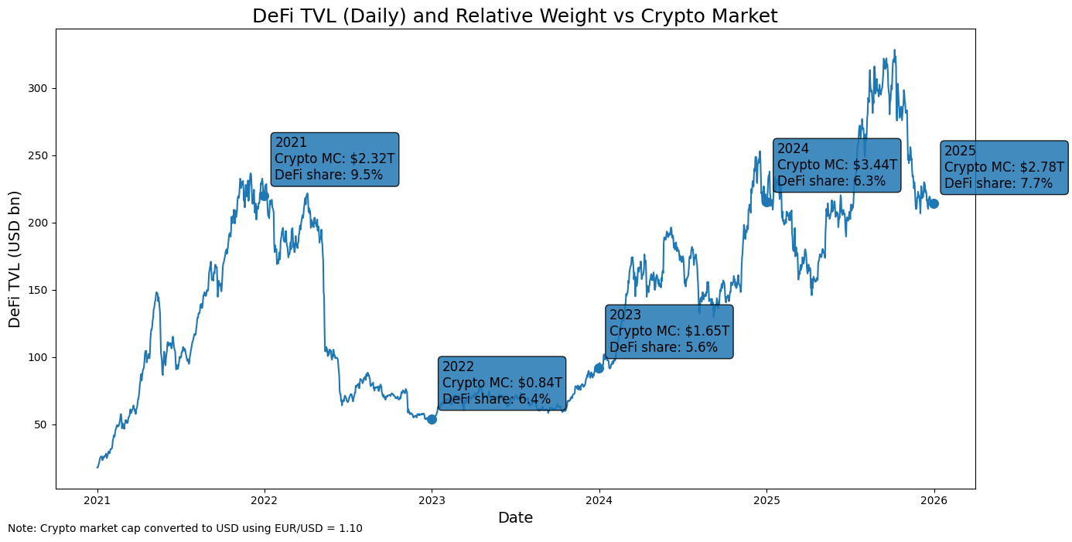
DeFi: size, scope and relevance
DeFi is a small share of crypto markets (upper bound ≈6–10%).
TVL is highly cyclical and volatile.

Slide 5
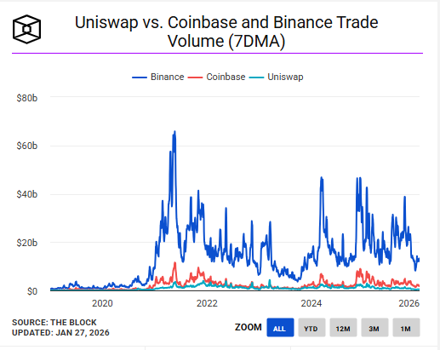
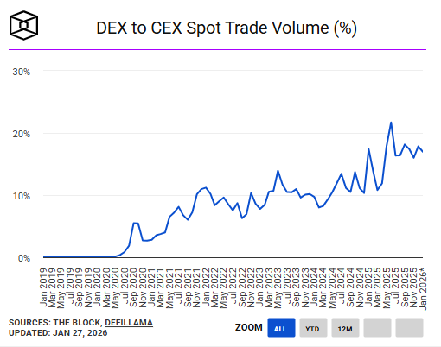
DeFi: size, scope and relevance

Slide 6
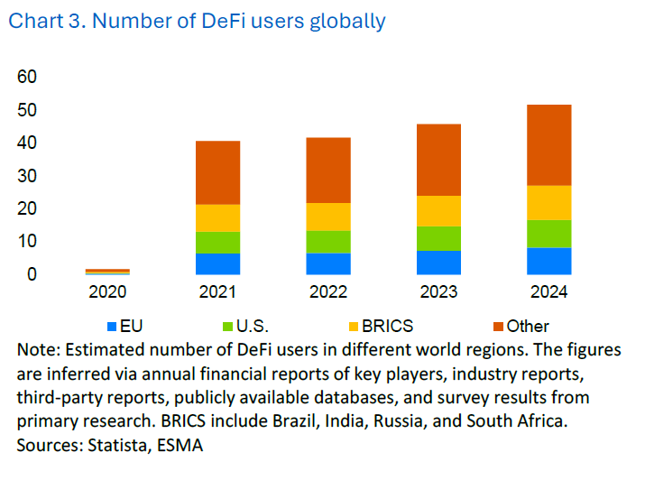
DeFi in the EU: supervisory perspective
Number of DeFi users globally
Most DeFi activity used by EU users is outside EU jurisdiction
Supervisors face exposure without establishment
Geographic attribution is highly uncertain
EU DeFi adoption is moderate, not dominant

Slide 7
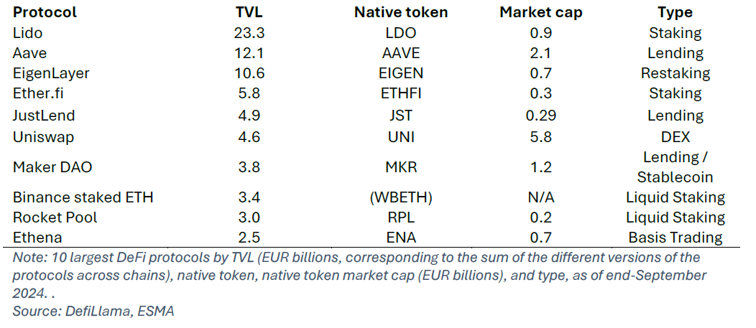
Why DeFi is small but not negligible
Size ≠ risk
Top 10 protocols ≈ 70–80% TVL
Systemic risk in formation

Slide 8



MiCA as the EU regulatory response
MiCA is the EU’s comprehensive regulatory framework for crypto-asset markets.
It aims to create a single EU market, strengthen investor protection and support financial stability and innovation.
It brings large parts of the crypto-asset ecosystem closer to established financial regulation.

Slide 9



What MiCA regulates
MiCA defines which crypto-assets and activities fall within the EU regulatory perimeter.
It covers:
- the issuance of crypto-assets
- the provision of crypto-asset services
It distinguishes between
- Asset-referenced tokens (STABLE COIN)
- e-money tokens
- other crypto-assets.
It introduces:
- disclosure requirements for issuers
- authorisation for CASPs
- market abuse rules.

Slide 10
MiCA: entity-based regulation vs DEFI
“MiCA regulatory logic (intermediated markets)”
“Decentralised finance (DeFi)”
Identifiable legal entities
Decentralised infrastructure
Obligations
Crypto-asset issuer
Decentralised governance (DAO)
Authorisation
Registration
Crypto-asset service provider (CASP)
(exchange, broker, custodian)
Smart contracts
Liquidity pools
Governance & organisational requirements
Permissionless access
Conduct-of-business
rules
Stablecoin issuer
(ART / EMT)
No identifiable issuer or service provider
Clear supervisory perimeter (accountability and enforcement possible)
No single accountable entity (entity-based regulation not directly applicable)
MiCA attaches obligations to entities; DeFi operates through infrastructure

Slide 11
Where MiCA draws the line
MiCA has clear scope limits: fully decentralised protocols fall outside direct regulation
DeFi remains a regulatory frontier, only partially covered via intermediaries and access points
Supervisory challenges go beyond MiCA, requiring monitoring and future policy tools

Slide 12
IOSCO principles as global reference
IOSCO - Final Report with Policy Recommendations for Decentralized Finance (DeFi) - December 2023
IOSCO promotes “same activity, same risk, same regulation” to ensure market integrity and regulatory consistency.
Applying this principle to DeFi is challenging, as activities are fragmented across protocols, interfaces and code layers without clear accountability.

Slide 13
Beyond the ‘no intermediaries’ narrative: DeFi as infrastructure and risk relocation
Intermediation persists but is reconfigured, often through interfaces and access layers
DeFi functions as financial infrastructure, with market rules embedded in code
Risk is relocated from institutions to protocols and users, challenging traditional supervision

Slide 14
Operational, governance and power-related risks in DeFi
Operational: DeFi misuse has caused tens of billions of USD in losses globally.
Technological: Incidents driven by smart contract flaws, oracle manipulation and cross-chain failures.
Governance: Low participation and token concentration reduce transparency and undermine market integrity.

Slide 15
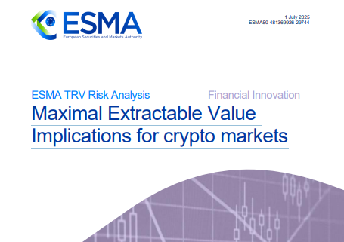
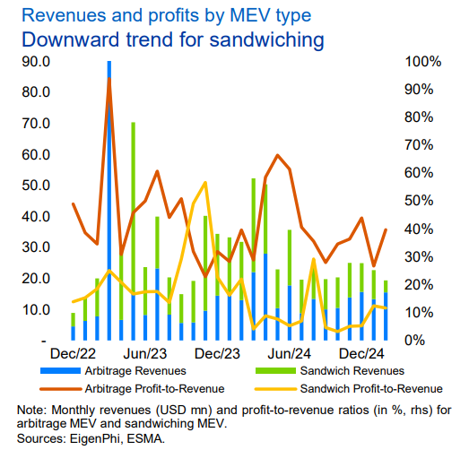
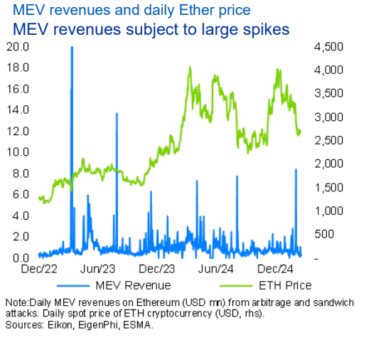
Market integrity and MEV
ESMA distinguishes multiple MEV practices, including arbitrage, front-running/sandwich attacks and liquidation strategies
MEV extracts value from transaction ordering, imposing indirect costs on other users
Market integrity risks arise from protocol design, not necessarily from illegal conduct

Slide 16
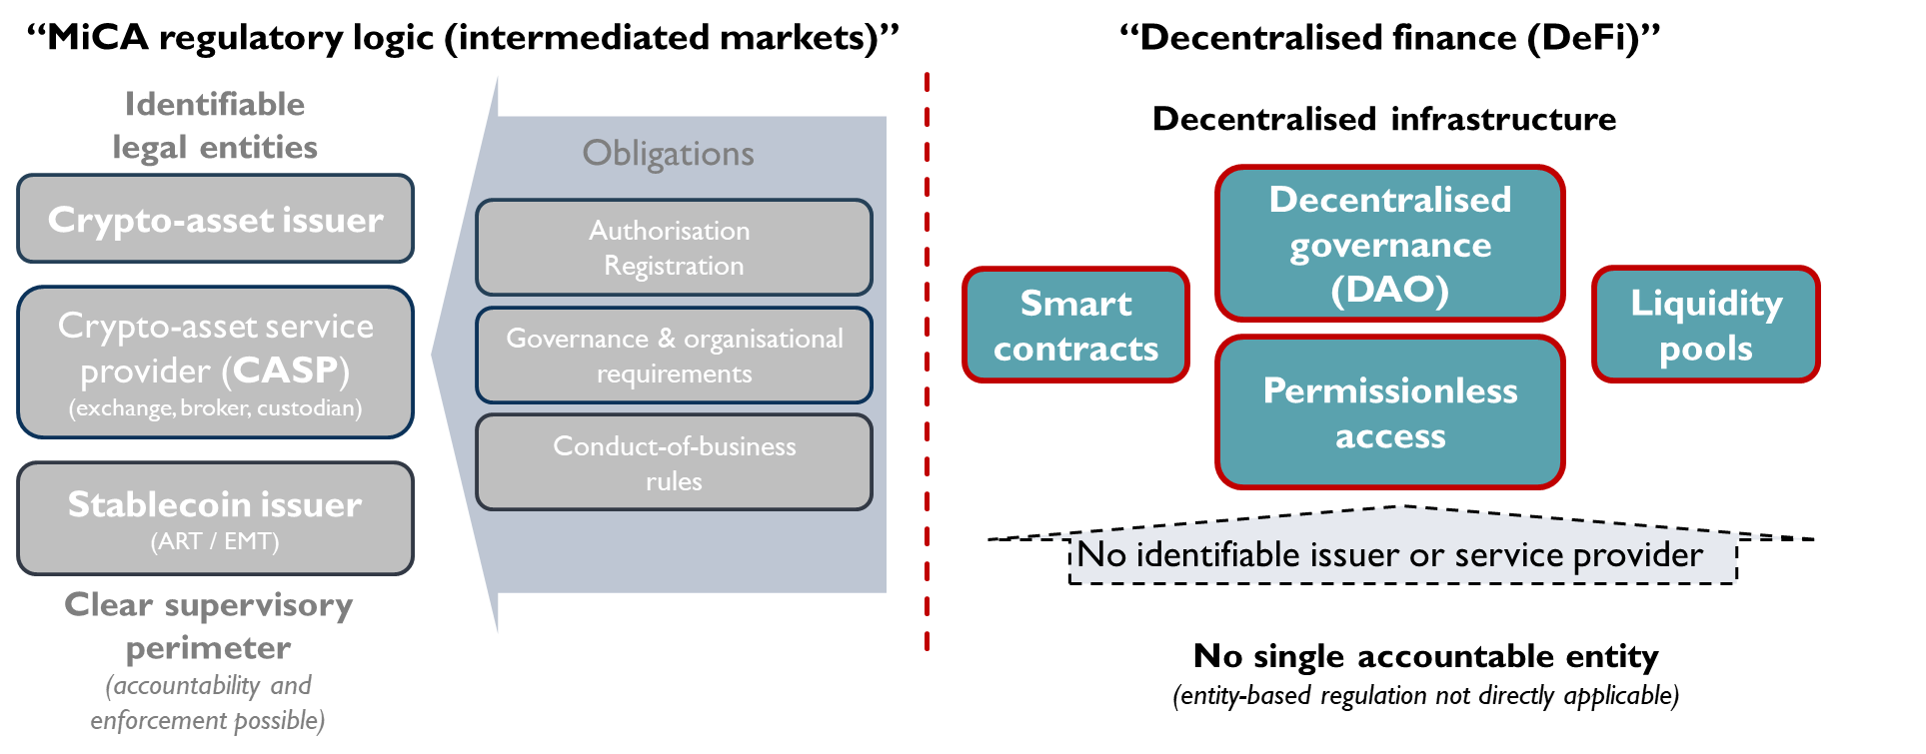
Limits of entity-based supervision
Entity-based supervision struggles in infrastructure-driven markets
Risk and control no longer align clearly with legal entities
Conceptual adaptation is required, not only legal extension

Slide 17
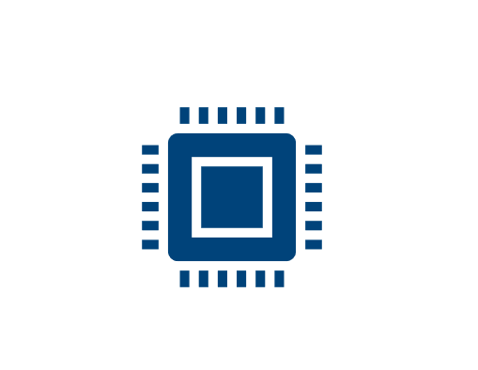
Code as a form of private ordering
Code replaces institutional discretion
Protocol rules shape incentives and outcomes
Private ordering emerges through infrastructure, not law

Slide 18
Emerging supervisory approaches
Increased reliance on
on-chain MONITORING
Interfaces emerge as key supervisory touchpoints
Understanding and monitoring precede intervention

Slide 19
Indirect application of MiCA rules to DeFi
DeFi may fall outside MiCA’s direct scope, but interactions with regulated CASPs remain subject to MiCA rules
Article 78(5) MiCA (Execution of orders for crypto-assets on behalf of clients), applies when client orders are executed by a CASP outside authorised trading platforms
Routing orders to DEXs triggers information and consent obligations for CASPs
Best execution and conduct responsibilities follow the trade into DeFi

Slide 20
Consob’s ongoing supervisory activity under MiCAR
Review of White Papers for crypto-asset offerings addressed to the Italian public
Blocking of websites and enforcement actions against unauthorised crypto offers and non-authorised CASPs
Ongoing assessment of CASP authorisation applications submitted at the end of 2025, following the expiry of the transitional regime for already operating VASPs

Slide 21
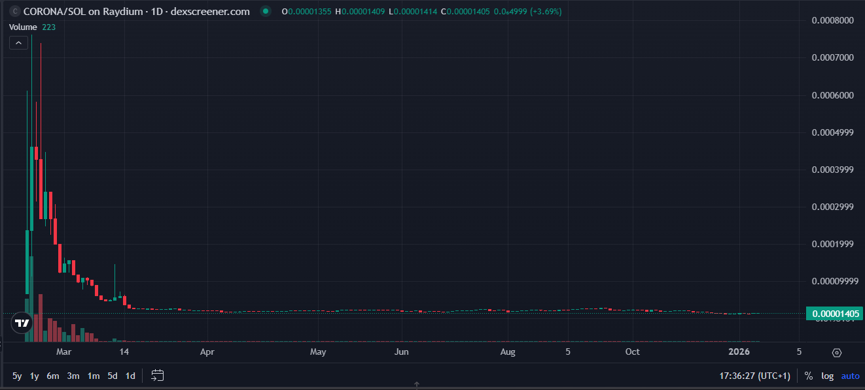
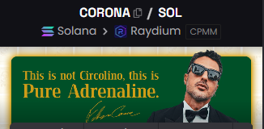
Consob decision on the “$CORONA memecoin” case
Promotion of the $CORONA memecoin to the Italian public through social media and a dedicated website
Offer carried out by a natural person, without a compliant White Paper and in breach of MiCAR rules
Consob intervention: termination of the offer, €200,000 fine, ban on repetition and public notice to investors

Slide 22
Consob decision on the “$CORONA memecoin” case
Promotion of the $CORONA memecoin to the Italian public through social media and a dedicated website
Offer carried out by a natural person, without a compliant White Paper and in breach of MiCAR rules
Consob intervention: termination of the offer, €200,000 fine, ban on repetition and public notice to investors
The breach did not relate to secondary market trading, but to the way the crypto-asset was offered to the public.

Slide 23
MiCA as framework for evolution
MiCA stabilises the regulated crypto perimeter
Explicit limits enable learning and adaptation
DeFi regulation remains evolutionary, not closed

Slide 24
Conclusion
DeFi does not represent the absence of order.
It represents a different form of order—decentralised, automated, and infrastructure-based.
The supervisory challenge is to understand this order and to ensure that core regulatory objectives—integrity, fairness, and trust—are preserved as financial systems evolve.

