Slide 1
User-specific Risk Premiums in a Decentralized Lending Platform
DeFi & Crypto Workshop @ Scuola Normale Superiore Pisa
Alberto Arrigoni, Nicolas Oderbolz
Notes:
Thank you for having us.
(Introductions)

Slide 2
Overview
Motivation: (Most) lending protocols rely on uniform pricing based on utilization rates, which fails to account for idiosyncratic risk preferences of individual users. This leads to adverse selection and prevents welfare-maximizing capital allocation.
Research Question: How can protocols optimally internalize individual risk externalities to enhance market volumes and systemic stability?
Method: We develop a micro-founded theoretical framework to model interest rate discovery and incentives. This is complemented by Monte Carlo-based scenario analyses to evaluate resilience.
Result: Combining individualized risk-based interest rates with stability pools enhances overall market outcomes without compromising systemic stability.
Notes:
First, we would like to give you an overview of what we would like to present to you today:
(Most) lending protocols rely on uniform pricing based on utilization rates. This is a good solution in that these pricing models are able to balance supply and demand for borrowing capital.
However, most of these platforms also require borrowers to be highly overcollateralized, which imposes a cost on borrowers.
As such, the do not account for idiosyncratic risk preferences of individual users. This leads to adverse selection and prevents welfare-maximizing capital allocation.
The question we ask ourselves here, in the specific context of the Folks Finance lending platform is:
Could it be possible to loosen collateral requirements and price in the risk externalities that may arise? Can this enhance market volumes and system stability?
To do this, we model different design approaches to this question and develop a simple Monte Carlo-based scenario analyses to evaluate protocol outcomes and resilience.
In short, our results suggest: In designing such a pricing scheme, there appears to be a clear trade-off between incentivizing additional borrowing to the platform and system stability in terms of preventing lender losses. However, we propose that

Slide 3
Intro to Folks Finance - Liquidity Fragmentation Problem
Challenge: Traditional protocols create separate pools per asset per chain. This splinters liquidity and creates inefficiency.
Siloed Multi-Chain (AAVE)
USDC Pool: 10M (Ethereum) + 10M (Avalanche) + 10M (Arbitrum) + …
→ 3 separate pools with 3 different rates
At Uopt=90%: 9M max borrow per chain/pool
Cross-Chain (Folks Finance)
USDC Pool : 30M unified pool across all chains
→ Single efficient aggregated pool
At Uopt=90%: 27M max borrow
(3x more capital efficiency)
Notes:
AA:
First, we would like to give you some context about Folks Finance and give you some background on our motivation.
….

Slide 4
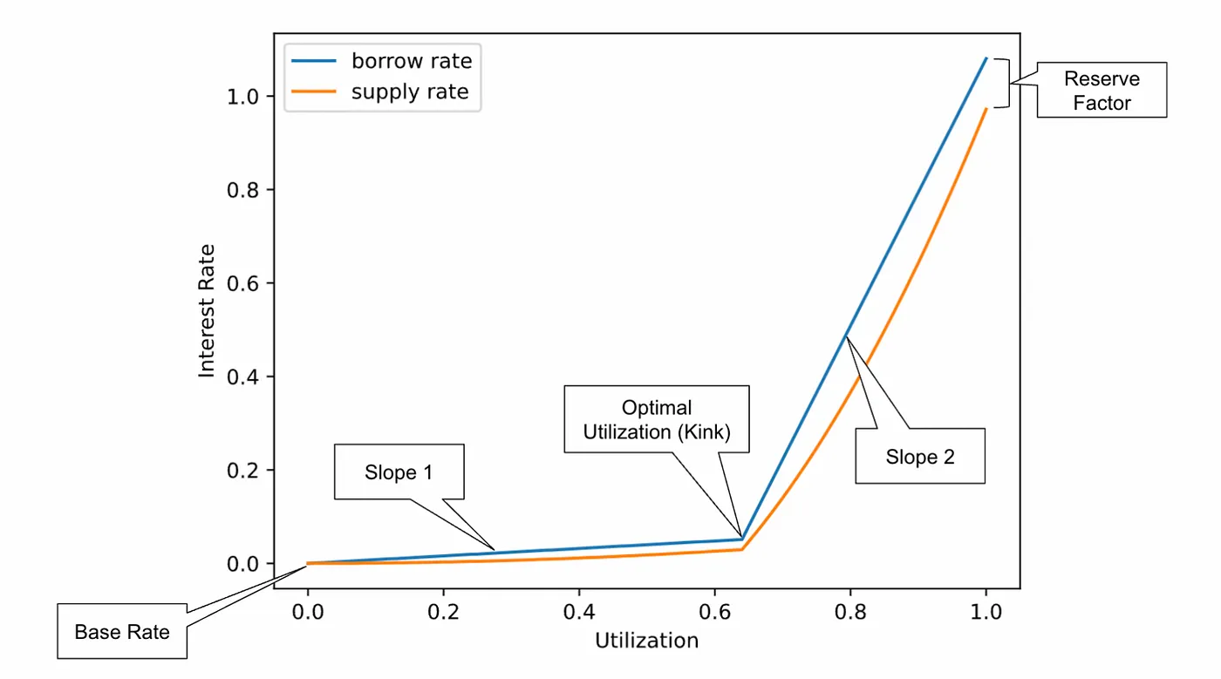
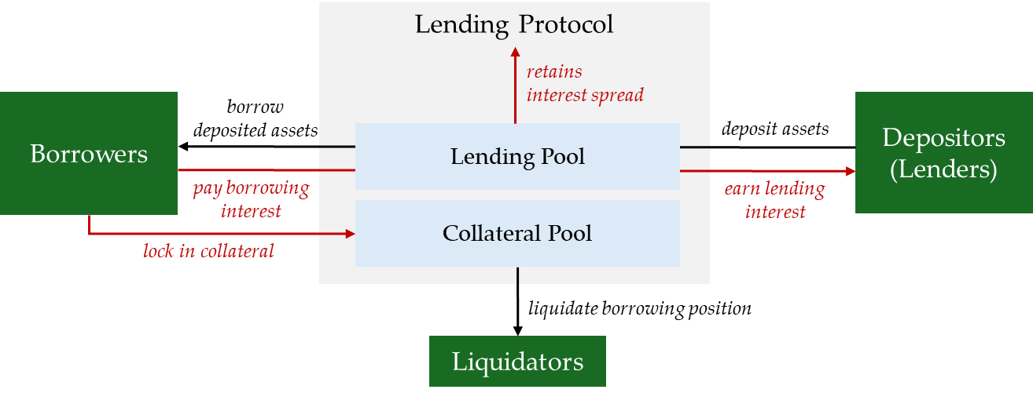
DeFi Lending: The Standard Model
DeFi lending protocols (Folks Finance, AAVE, etc.) provide permissionless pooled-risk markets:
Utilization-based interest rate model
Interest rates depend on utilization of deposited capital
Uniform (over-)collateralization requirements for borrowers
Notes:
Folks Finance and other lending protocols are multi-sided platforms, acting as intermediaries between interdependent groups (in particular, lenders and borrowers).
The main challenge for a platform with cross-network effects is to bring all user groups on board.
Successful lending protocols are an attractive proposition for both borrowers and lenders.
Notably, the platform must determine its pricing strategy, which is crucial for influencing various groups to join.
In practice, lending platforms set the interest rate 𝑖 based on the so-called utilisation ratio 𝑈, which describes how much of the available assets in a pool (deposited amount) are borrowed.
In addition, protocols typically set uniform collateralization requirement. They are set high enough such that the risk of undercollateralized liquidations are sufficiently low.
This is of course costly for borrowers, who may have opportunity costs on the collateral they are required to provide.

Slide 5
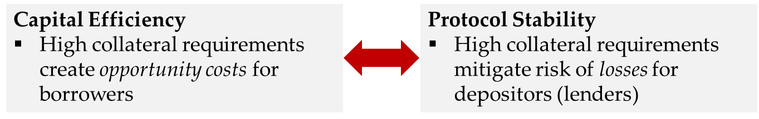
Improving the Standard Model
The choice of collateral factor CF (i.e., the maximum percentage of the collateral value that a borrower is allowed to borrow) requires balancing a trade-off between borrower and lender incentives:
Problem:
This trade-off is not incorporated in typical pricing models
Borrow rates depend only on utilization U, NOT on individual risk preferences
Solution: Introduce price differentiation based on borrower risk preferences
Notes:
In particular, in setting the collateral factor (i.e. the maximum percentage of the collateral value that a borrower is allowed to borrow), the protocol has to balance borrower and lender incentives.
On the one hand, borrowers are looking to optimize capital efficiency. Locking in high amounts of collateral relative to what they can borrow obviously creates opportunity costs.
On the other hand, lenders might prefer high collateral factors, since the want to mitigate the risk of undercollateralized liquidations, and them losing a part of their deposit.
As we said, this trade-off is typically not incorporated in current pricing models, it is simply subject to the collateral factor set at the protocol level.
Borrow rates depend only on utilization U, NOT on individual risk preferences
So one could argue that the CF is simple set conservatively high
One possible solution and one we want to investigate with our research here is that one could think about price differentiation at the borrower level. In particular, price differentiation based on borrower risk and collateralization preferences:
Borrowers who wish to minimize the collateral they have to lock up, pay an additional premium and this risk premium compensates lenders for the additional risk they carry.
[2.15min]

Slide 6
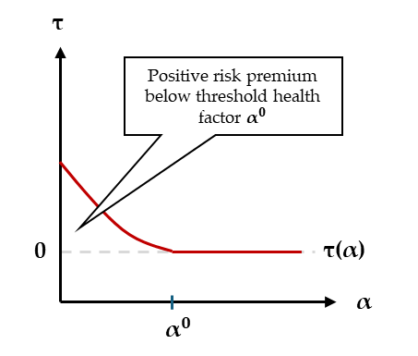
Solution: User-specific Risk Premiums
Charge user-specific risk premiums:
E.g. by introducing risk premium based on borrower-specific health factor
In turn, reduce collateral requirements relative to baseline
Research Questions:
How does this affect borrowing incentives, protocol revenues, etc.?
How should new revenues be optimally redistributed to preserve protocol stability?
Method:
Model design space within a micro-founded theoretical framework of the Folks Finance Protocol
Run Monte Carlo-based simulations to evaluate resilience
Notes:
There are obviously several ways one could think about designing such a solution.
One idea we explore in the following has two basic components:
1. Lowering collateral requirements at the protocol level → higher collateral factor for a given collateral asset
And 2. We introduce a risk premium schedule that depends on an individual borrowers health factor
In effect, the borrower pays an additional premium when they borrow close to the maximum borrowable amount, and as such pays a price for the increased risk they pose for lenders on the platform.
On this basis, we ask several research questions:
The first is how such a change to the protocol could potentially affect borrowing incentives, assets supplied to the protocol, as well as protocol revenues? → Does it make sense from an economic perspective?
And two, we ask how these new revenues from the risk-premium scheme should be optimally redistributed, preferably in a way that preserve protocol stability.
To do this, we first define a design space that captures several risk-premium parameter settings, as well as different options for redistribution of risk-premium revenues, incorporate them in a simple model, and perform numerical simulations.
[2min] → shorten a bit

Slide 7
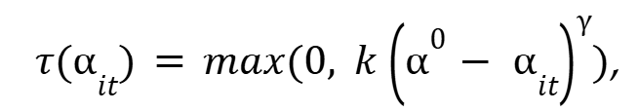
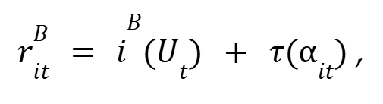
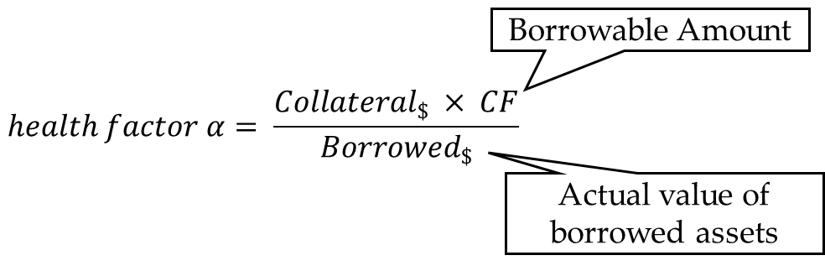
Design Space - Risk Premium
We extend the Folks Finance model by introducing a borrower-specific risk premium based on health factor 𝛼:
where the health factor 𝛼 is defined as:
The general risk premium τ:
Notes:
So, let me give you a general overview of the specific design of the risk premium we consider.
First, based on discussions with Folks Finance, we believe an additive approach could be most appropriate.
This means we leave the current utilization-based interest rate schedule, which has been proven successful unchanged.
We simply add a risk premium component to the borrowers interest rate schedule, which depends on their health factor.
The health factor is defined as the ratio between the borrowable amount (the value of the collateral times the collateral factor) and the value of the borrowed assets.
When the health factor is large → risk of liquidation is low
When the health factor is low → risk of liquidation is high (already a small movement in the price/value of the collateral can lead to the liquidation of the position
If the health factor drops below 1, liquidation is possible → this does not change!
In terms of the functional form of the risk-premium schedule, we make the following general assumptions:
Increases as collateralization / health factor declines
Is strictly non-negative (no subsidies for low risk)
Can potentially be non-linear, so can exponentially penalize riskier positions
In following, we evaluate different parameter settings and investigate their impact on protocol level outcomes.
[2:30 min]

Slide 8
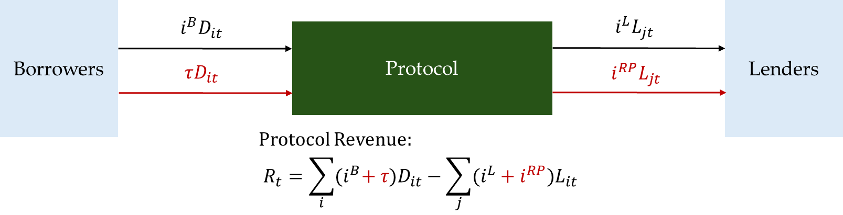
Design Space - Redistribution
A: Direct Redistribution to Lenders:
Notes:
As we outline earlier, we also want to think about the optimal way to redistribute the additional revenues from the risk premium.
In general, we explore two options.
One is to retain the current structure of the Folks Finance protocol and simply redistribute the additional revenues to lenders, subject to a small retention fee.
This mechanism increases the nominal interest rate received by lenders but offers no additional stability mechanism.
In this case, we simply assume that the additional interest provided to lenders is enough to compensate them for the additional risk they carry.
[0.5 min]

Slide 9
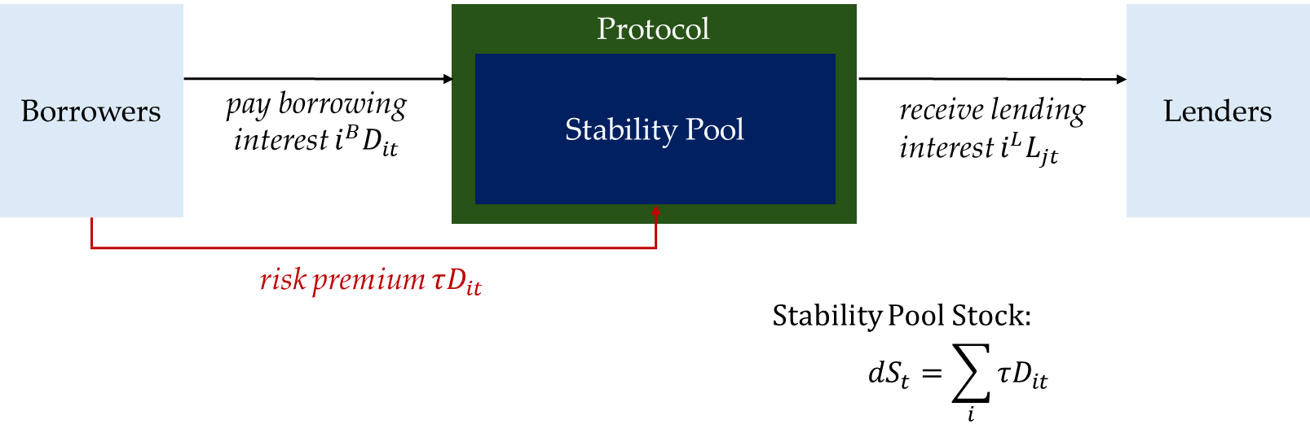
Design Space - Redistribution
B: Internal Stability Pool (Treasury):
Notes:
Another approach could be to, instead of creating additional yields for lenders, we use the revenues to introduce new stability mechanisms, which can, in addition to the incentives created by the risk premiums themselves, aid in maintaining protocol stability.
In particular, we are thinking about retaining risk premiums in a stability pool.
One version of this is depicted here:
Risk premiums are sequestered into a reserve designed to absorb capital shortfalls from undercollateralized liquidations, akin to a treasury.
In this regime, the reserve acts as a primary buffer. Residual losses exceeding the fund’s capacity are socialized among lenders.

Slide 10
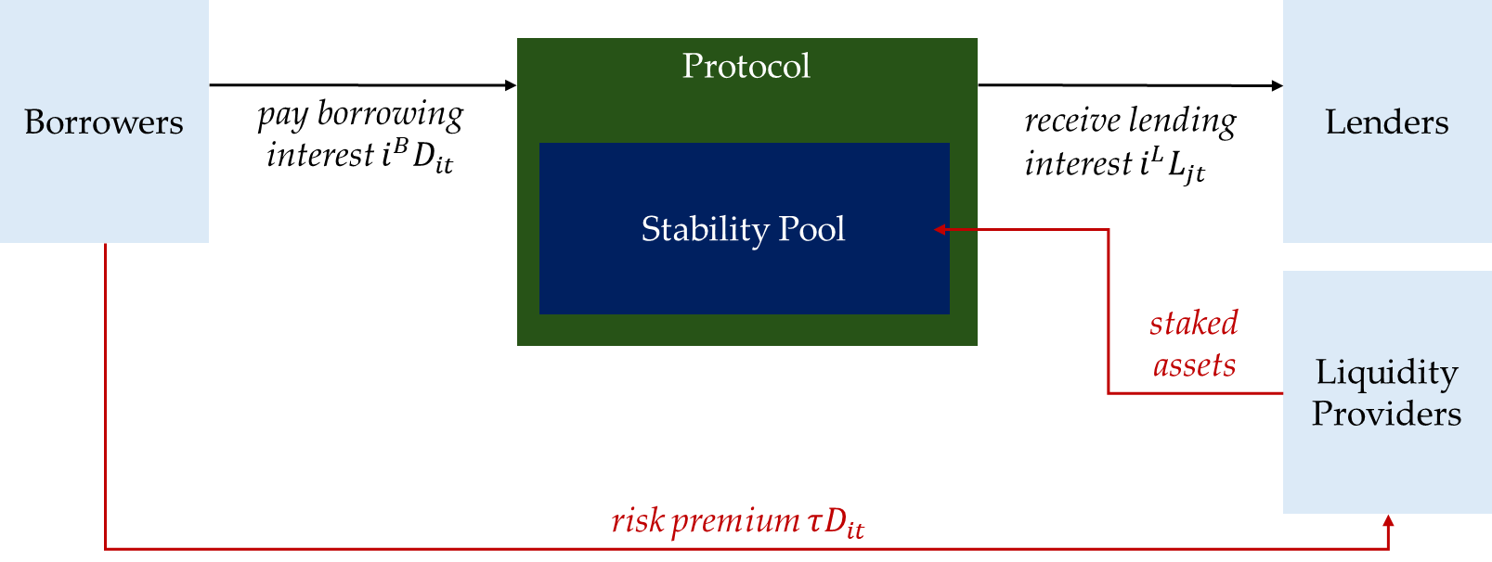
Design Space - Redistribution
C: External Stability Pool:
Notes:
Another approach could be to introduce a stability pool akin to the AAVE Umbrella model.
Revenues are utilized to subsidize liquidity provision to the stability pool through external liquidity providers.
Again, any residual losses exceeding the stability pool’s capacity are again socialized among the lenders.
[2min]

Slide 11
Model / Simulation
Design options are modeled in a discrete-time stochastic model of the Folks Finance Protocol
Single collateral and borrowing asset pair with a stochastic price process
Borrowers optimize collateral and debt based on
risk preferences (target health factors)
opportunity cost of collateral
interest rates relative to external markets
Lenders adjust capital supply based on protocol yield versus outside option
Notes:
So, how do we evaluate these different design options:
We implement them in a simple discrete-time stochastic model of the Folks Finance protocol with heterogeneous borrowers and lenders.
We then run numeric simulations of this model and compare outcomes with a baseline version that replicates the current version of the Folks Finance protocol with only utilization-based interest rate schedules.
The time constraint doesn’t allow me to go into full detail on the model, but let me give you a flavour of the most important modeling decisions and assumptions:
The highest degree of detail in the model is in regards to how we model borrowing behaviour.
We model borrowers as optimizing their debt and collateral demand subject to the stochastic development of macro variables (ETH price, risk free rate, borrowing costs in the overall lending market, etc.).
Their choice of optimal debt depends on
individual heterogenous risk preferences (which are modeled as a target health factors),
the opportunity cost of locking in collateral,
and the borrowing interest rates relative to external markets.
Lenders have a simpler underlying choice structure, they simply adjust capital supply based on protocol yield versus outside options.
We have some slides in the appendix that show the mathematical definition of the state update functions for lender and borrowers, as well as the parameter settings we choose for these. Happy to go into more detail on this if there is interest.
[2 min]

Slide 12
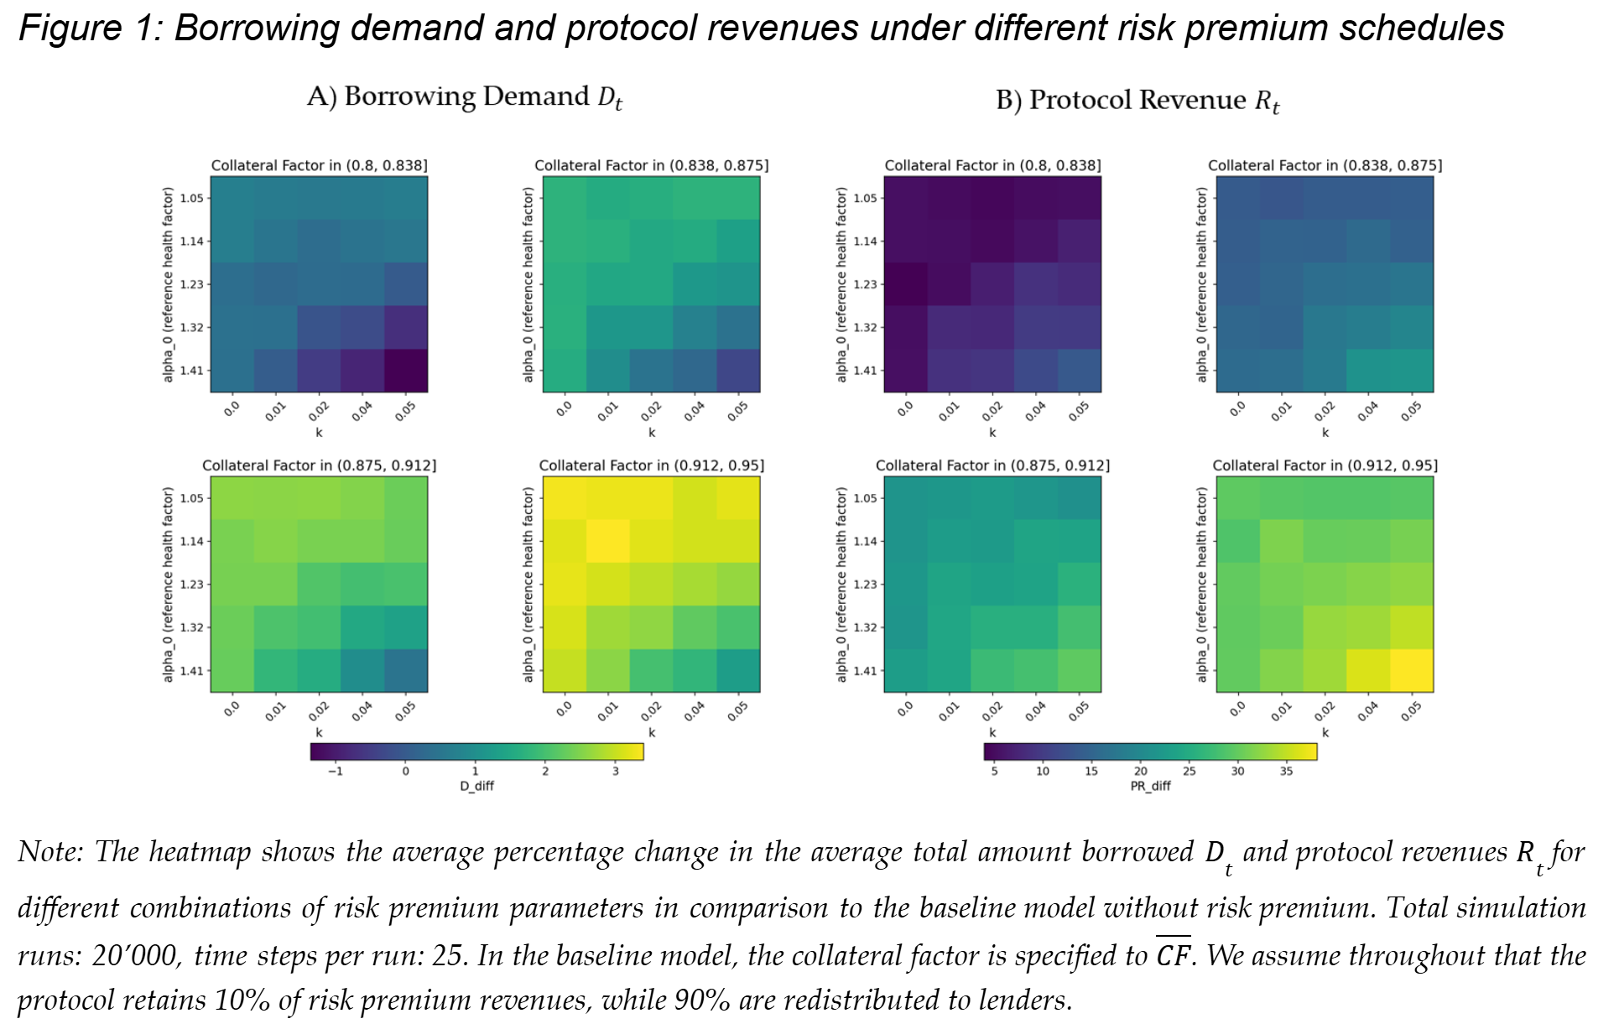
Results I - Effects on Borrowing Volume and Revenues
Notes:
So let’s look at the some of the more interesting preliminary results we arrive at:
The figure you see here illustrates the average change of aggregate borrowing demand and protocol revenue across different simulation runs runs and for different choices of risk premium parameters k, alpha 0 as well as the new CF relative to the baseline utilization-only model of the Folks Finance protocol.
A key finding is that introducing higher allowable collateral factors alongside a health factor–based risk premium does not universally lead to increased borrowing demand.
We find that the most pronounced expansion in demand—representing a 1.5% to 2% increase in total borrowing—occurs in regimes where substantial CF liberalization relative to the baseline is paired with a moderate risk premium.
In these configurations, the total protocol income rising by up to 30% (given a moderate retention rate of 10%).
Conversely, stricter risk premium regimes (characterized by higher k and alpha 0) generate a contractionary effect, where the increased cost of capital suppresses borrowing demand and yields only marginal revenue gains relative to the baseline.
Based on this result, the obvious question is, can a moderate risk tax be used to mitigate addition risks of undercollateralized liquidations.
[2min]

Slide 13
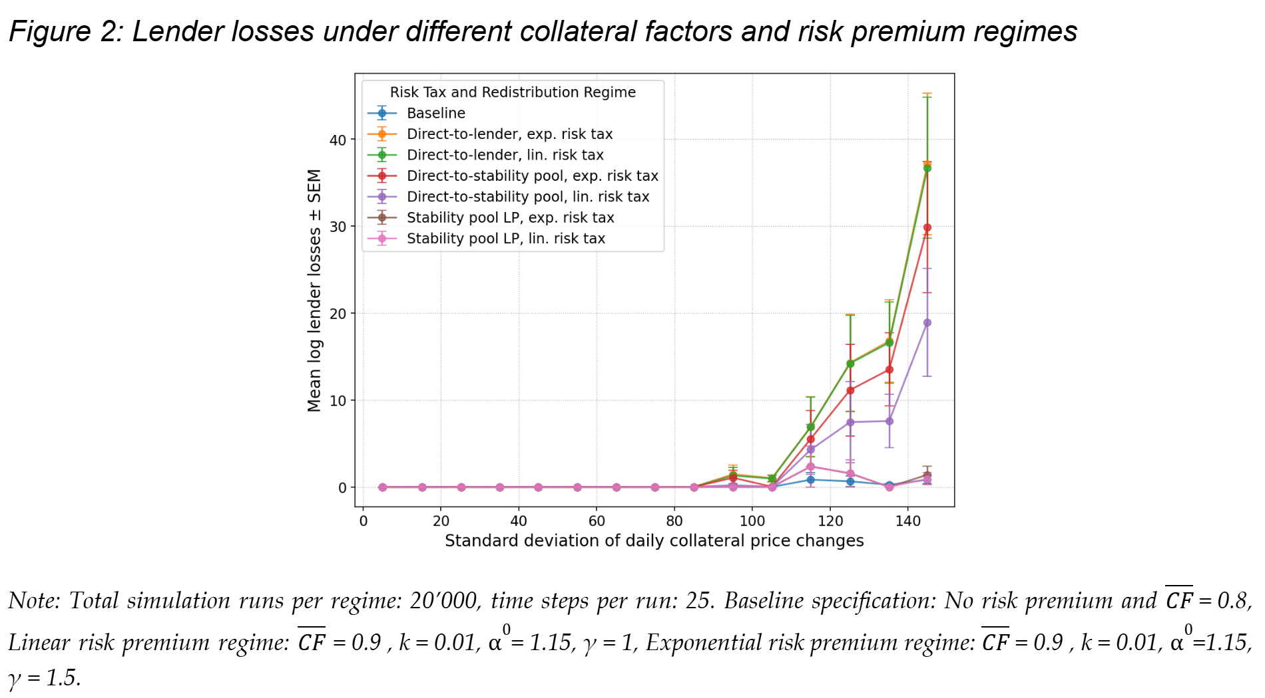
Results II
Notes:
Thats exactly what we do here
We assess how the three redistribution mechanisms mentioned above are able to mitigate losses from undercollateralized liquidations across varying price volatility regimes of the collateral asset
What you see here is the average lender losses from undercollateralied liquidations across simulation runs for different redistribution mechanisms and underlying volatility of the collateral asset.
We compare this to the simulations of the current folks finance protocol settings (the baseline).
As expected, our results indicate that in low-volatility environments, the choice of redistribution mechanism is largely neutral, as liquidation events are infrequent.
However, as price volatility of the collateral asset increases, the structural design becomes a primary determinant of protocol resilience.
Particularly, both the “Direct Yield Distribution Lenders” and “Treasury model of the Stability Pool” models exhibit a failure to contain tail risk in high volatility environments and moderate risk premium specifications, with lender losses exceeding baseline levels, suggesting these designs cannot fully offset the systemic risk introduced by higher collateral factors CF and moderate risk premiums.
In contrast, the mechanism utilizing risk premiums to incentivize external liquidity provision to the stability fund maintains stability levels comparable to the baseline, even under high volatility.
[2 min]

Slide 14
Discussion
Trade-off: Liberalizing collateral constraints in combination with a risk premium can better serve borrowing demand and increase volume. However, this comes at the cost of additional risk to lenders
Stability pool mechanism: Using risk-premium revenues to incentivise a dedicated stability pool (such as the AAVE Umbrella Module) provides an effective first-loss buffer and can preserve lender protection
Market equilibrium: Combining individualized interest rates with stability pools enhances overall market outcomes without compromising systemic stability
Notes:
So what do these results show us?
Our simulation results demonstrate that liberalizing collateral constraints—when paired with a risk premium - can under the right circumstances expand borrowing demand and protocol revenue.
However, this introduces heightened risk of undercollateralized liquidations, as the risk premium alone fails to fully internalize the negative externalities associated with lower collateralization, even when it is reserved by the protocol to cover shortfall risks.
Rather, utilizing risk premium revenues to incentivize a dedicated stability pool, akin to the umbrella model employed by AAVE, may achieve a sufficient loss buffer to maintain lender loss profiles comparable to the status quo.
Overall, the results provide initial evidence that combining capital efficiency gains with robust risk-pricing and stability buffers could offer a viable path for protocol growth without compromising systemic integrity.
Of course, these results are not nearly enough to think about a concrete application:
Currently, the stochastic processes in the background are relatively naive, we would need to calibrate them using empirical data
Also, we would need to think about implementation in more detail. Considerations like gas costs and operational complexity are important limitations when it comes to deployment, and these aspects are not sufficiently covered in the model.
[2 min]

Slide 15
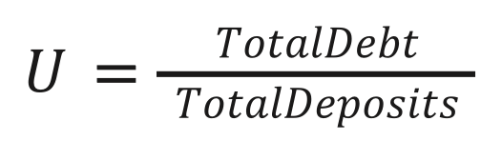
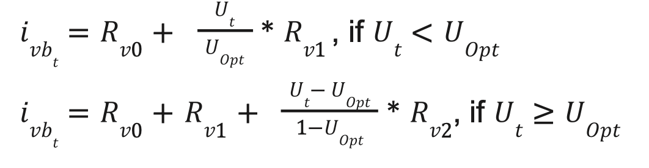
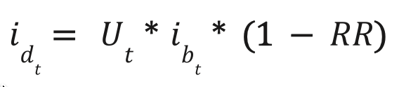
Appendix - Monolithic Lending: The Standard Model
All DeFi lending protocols (Folks Finance, AAVE, Compound, Morpho) use permissionless pooled-risk markets governed by:
Utilization Ratio:
Borrow Rate:
Deposit Rate:

Slide 16

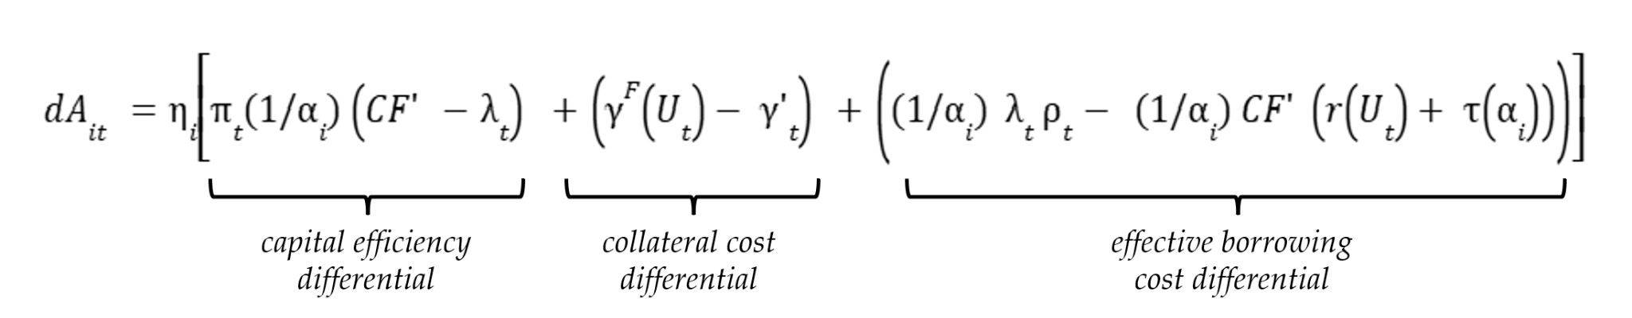
Appendix - Modelling Details I
Borrower Demand
Each borrower i targets a specific health factor 𝛼_i. Thus borrowing demand is defined as follows (depends on the borrowable amount):
The change in borrowing demand is then defined as a function of the amount of collateral supplied to the protocol
Notes:
Capital Efficiency Differential: The first term compares the collateral factor on Folks Finance to the collateral factor available in the broader market (e.g. AAVE). A positive difference indicates that Folks offers greater capital efficiency than market alternatives, all else being equal, which increases borrowing demand, and as such the amount of collateral supplied by the borrower.
Collateral Cost Differential: The second term compares the annual percentage yields on the borrower's collateral between Folks and the market. If the APY on Folks is lower, it implies a lower opportunity cost for supplying collateral, thereby increasing the borrower’s incentive to use Folks. In the following, we assume for simplicity that there is no difference in collateral yields between Folks and the market
Effective Borrowing Cost Differential: The third term compares the effective borrowing interest rate faced by the borrower on Folks to that of market alternatives, accounting for the current utilization Ut and interest rate schedule rUt. A lower effective rate on Folks implies reduced borrowing costs, which again increases the supply of collateral from borrower i, everything else held equal.

Slide 17
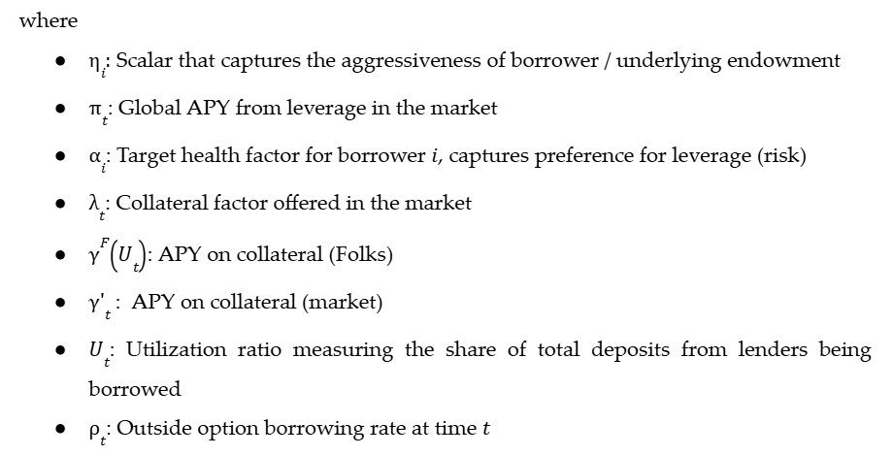
Appendix - Modelling Details II

Slide 18
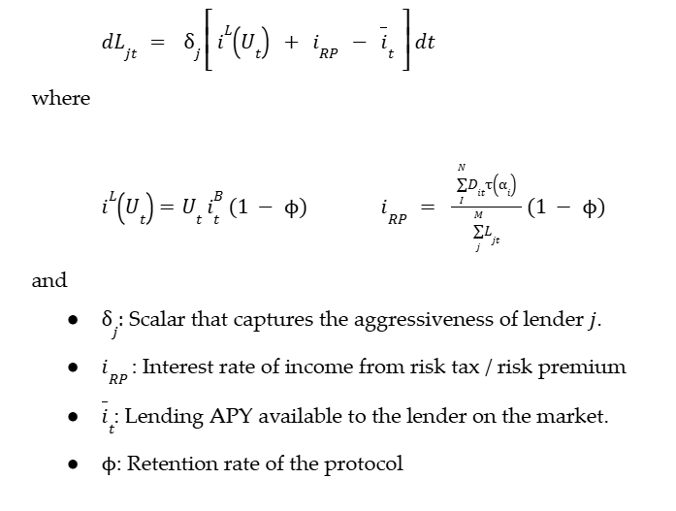
Appendix - Modelling Details III
Lender Supply
Notes:
Lenders adjust capital supply based on protocol yield versus outside options

Slide 19
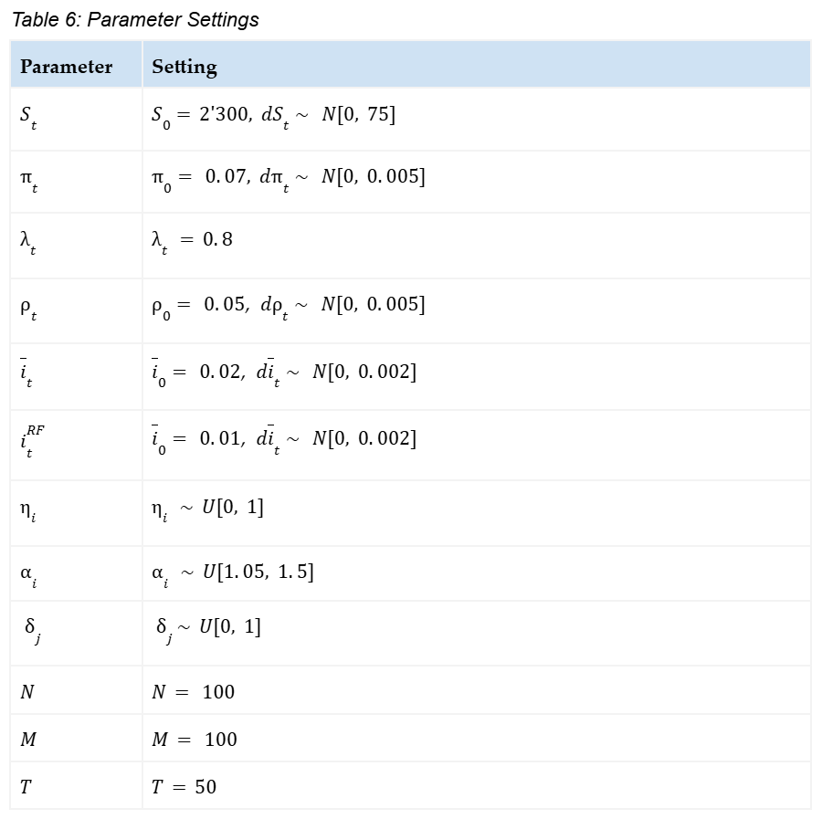
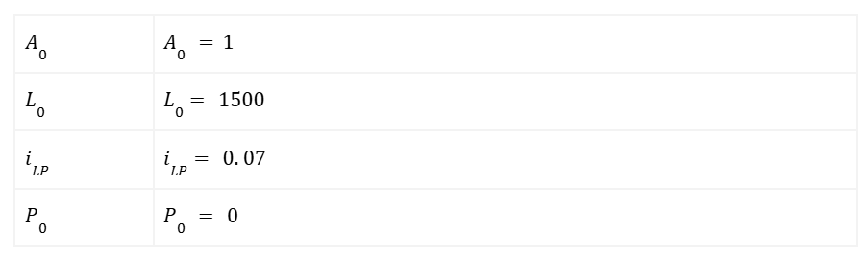
Appendix - Model Calibration

